Slide 1
Deciphering doggies
Keras Image Recognition
Adam Burrows & Nick Zamora

Slide 2
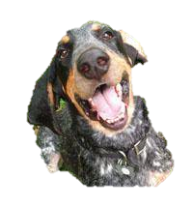
Overview
Background & Inspiration
Questions
Data
Preliminary Analysis
Results
Future Direction & Obstacles
Reference

Slide 3
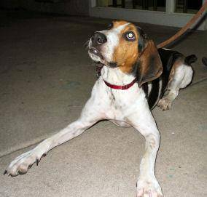
Background
Image recognition
Medicine, agriculture, finance, astronomy
Common use implements CNNs
Machine learning system
Keras and TensorFlow

Slide 4
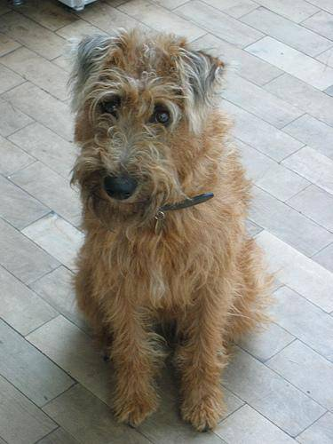
Inspiration
Dogs are man’s best friend
Concept not covered in MSDA
Resume building
Extensions outside the scope

Slide 5
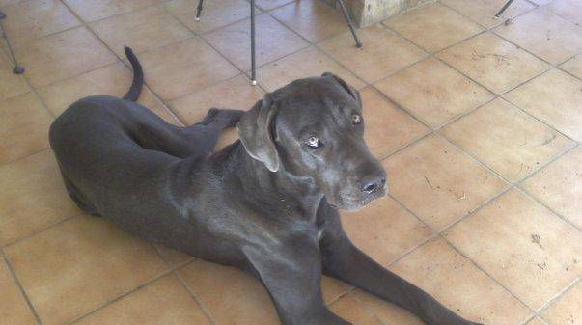
questions
What are the most/least commonly classified dog breeds?
How accurately can the algorithm classify images of dogs?

Slide 6
DAta
Open source from Kaggle
The images are separated into training and testing data (threw out testing set)
Full dataset: 10,222 classified jpeg images
Use an 80:20 ratio for train:test
CSV file containing labels for these10,222 images

Slide 7
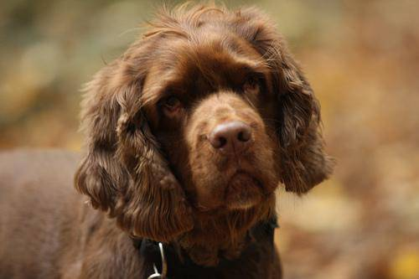
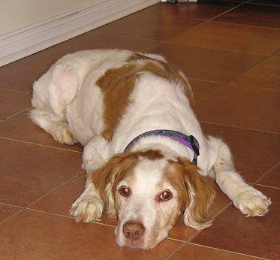
Preliminary analysis
Clustered the 120 dog breeds into 10 main breeds
Terrier 6. Spaniel
Retriever 7. Schnauzer
Hound 8. Husky
Poodle 9. Shepherd
Bull 10. Toy
Removed images without labels
Resized all images to 100x100 pixels

Slide 8
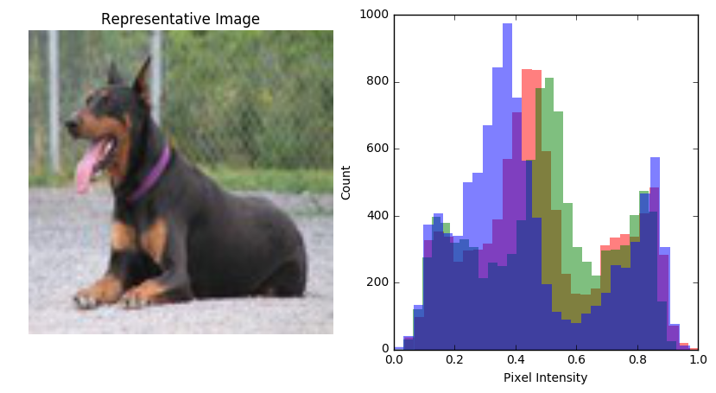
Preliminary analysis
Normalized pixel values

Slide 9
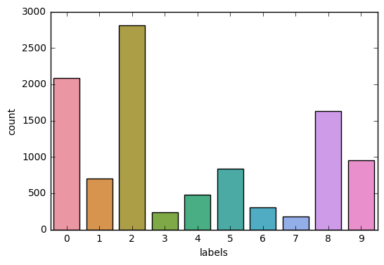
Preliminary analysis
Terrier
Applied heavier weights based on imbalanced breed clusters
Hound
Shepherd

Slide 10
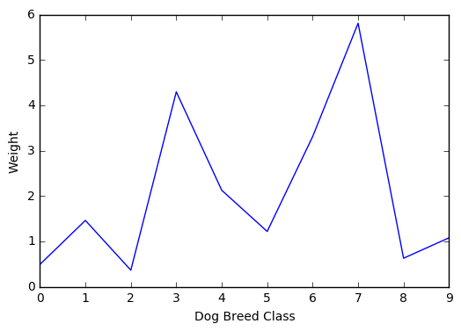
Preliminary analysis
Applied heavier weights based on imbalanced breed clusters

Slide 11
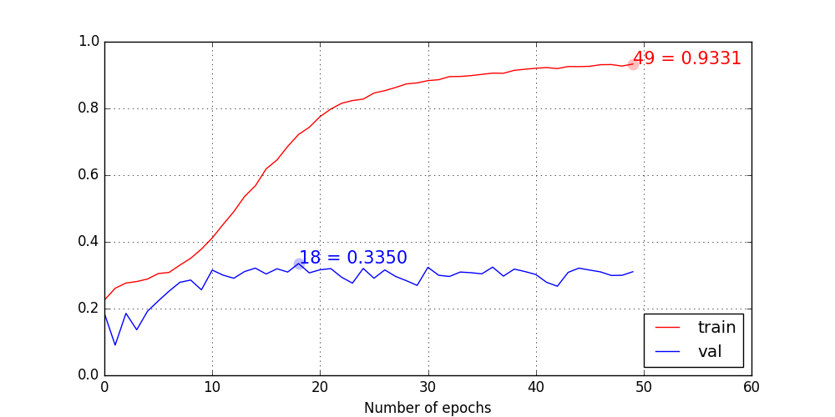
results
80:20 split
Produced horrible test error
50 epochs each taking 8 seconds

Slide 12
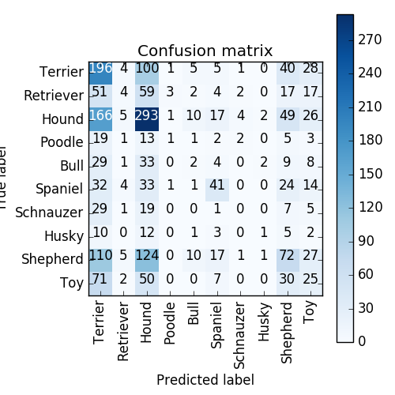
results
High Terrier, Hound, and Shepherd classification accuracy
Mostly misclassifies images as Terrier, Hound, Shepherd, and Toy

Slide 13
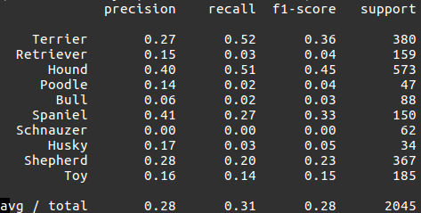
results

Slide 14
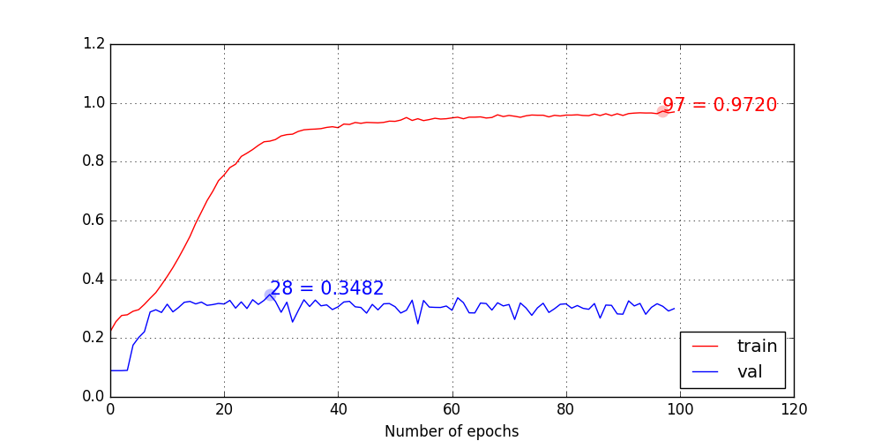
results
70:30 split
Produced horrible test error
100 epochs each taking 8 seconds

Slide 15
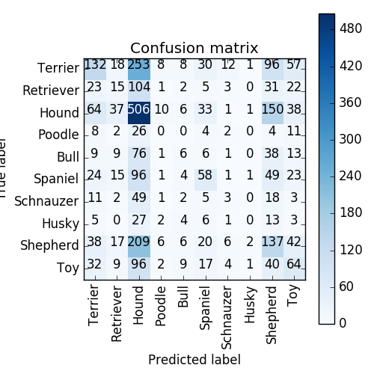
results
High Terrier, Hound, Spaniel, Shepherd, and Toy classification accuracy
Mostly misclassifies images as Terrier, Retriever, Hound, Shepherd, and Toy

Slide 16
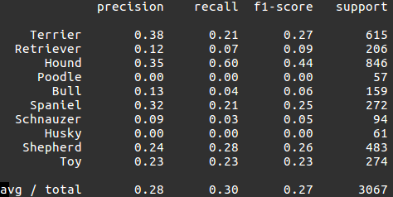
results

Slide 17
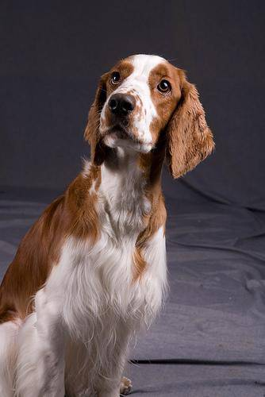
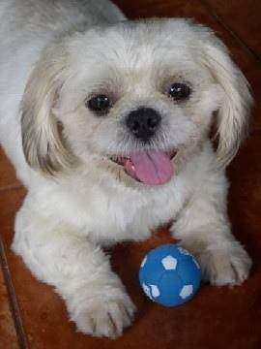
Future direction
CNN using TensorFlow
Grayscale model
Better?
Faster?
Alternate optimizer
Resize images

Slide 18
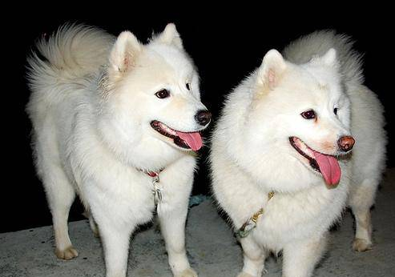
obstacles
Need unsupervised access to super computer
GPU is the only option for results
More images with labels
Better breed clustering
Additional features
Weight
Height
Breed characteristics

Slide 19
reference
Kaggle (2018). Dog Breed Identification [Data file and code book]. Available from Kaggle Competitions website: https://www.kaggle.com/c/dog-breed- identification/data

Slide 20
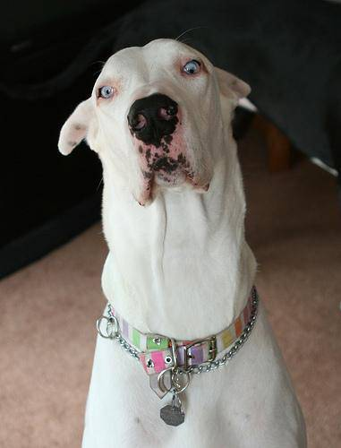
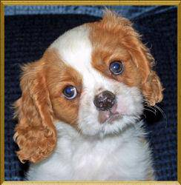
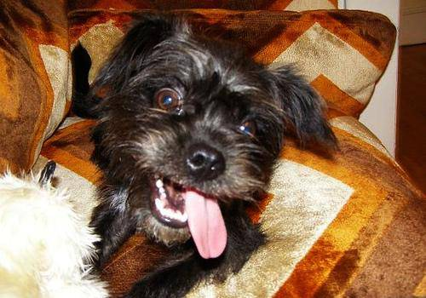
Questions?

